Slide 1
“Year 3000” Future proof settlement agreements, compromising future claims and making payments efficient
By Naomi Gyane
E. n.gyane@pumpcourtchambers.com

Slide 2
Why future proof Settlement Agreements?
1. Ongoing working relationships.
2. Whistle-blowing complaints
3. Post-termination detriments.
4. Post-termination discrimination and harassment
5. Post-termination victimisation
Section 123 (a) EA 2010: conduct extending over a period is to be treated as done at the end of the period; Constructive Dismissals (Woods v WM Car Services (Peterborough) Ltd [1981] IRLR 347, para 17 conduct as a whole and cumulative effect assessed).
Making protected disclosures are usually excluded from general waivers of claims.
3. Onyango v Berkeley (trading as Berkeley Solicitors) [2013] All ER (D) 178 (Mar) – The Tribunal has jurisdiction to consider post-termination whistleblowing disclosures and detriments under Section 47B ERA 1996.
4. Section 108 EA 2010 extends prohibition on discrimination and harassment to employment that has ended.
5. Jessemey v Rowstock Ltd and another [2014] EWCA Civ 185 – Post-termination victimisation has been read into the Equality Act 2010

Slide 3
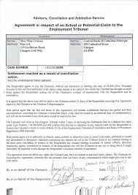
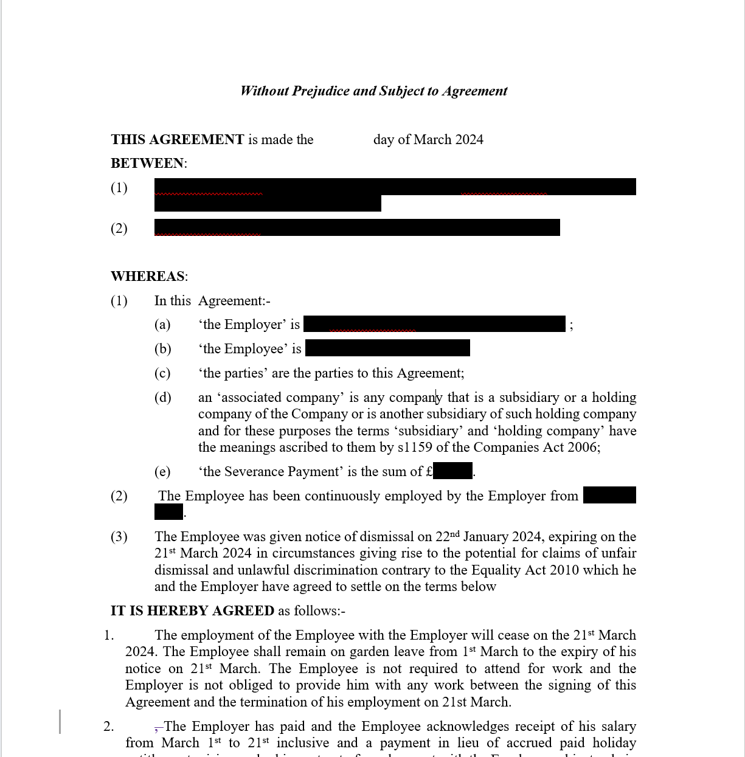
Compromising claims
Section 203 Employment Rights Act 1996/ Section 144 Equality Act 2010
A contract is unenforceable where it excludes or limits the claims that can be brought pursuant to statute.
The exceptions:
COT3 AGREEMENTS
SETTLEMENT AGREEMENTS

Slide 4
COT3 AGREEMENTS
Involves ACAS Conciliation Officer
Usually after a claim is commenced.
Doesn’t require either party to obtain legal advice.
It will only compromise Tribunal claims within the presumed contemplation of the Parties unless expressly widened (Livingstone v Hepworth Refractories plc [1992] IRLR 63, EAT).
It can cover disputes that have not yet arisen yet (Bank of Credit and Commerce International SA v Ali [2001] IRLR 292, HL)

Slide 5
Future proofing your COT3 Agreement
Bank of Credit and Commerce International SA v Ali [2001] IRLR 292, HL
In considering the appropriate form of words to be used, the following points arising from the decision may be noted:
(a) In construing a release, courts will look to the wording of it and construe it against the context in which it was agreed.
(b) In the absence of clear words, the context will be taken to mean the law as it stands and not as it may turn out to be; it will not be taken to include future changes in the law having retrospective effect.
(c) In the absence of clear words, the scope of the claims covered will be narrowly confined; so if, for example, claims arising out of the whole of the employment relationship, and not just out of the termination of the relationship are to be covered, that must be spelled out; if PI claims are to be covered, that should be spelled out.
(d) If the employer knows of an actual or possible claim that the employee does not know about, that will not be covered. If the employer wants to ensure it is covered, he is going to have to mention it to the employee to see if he will agree to release it.
(e) In general it does not seem to matter whether separate consideration is given for the release, or whether the release is just part of an overall agreement settling or compromising the claim.
(f) There is still no guarantee that even 'clear words' will be sufficient in every case; the corollary to that observation is that when judges think that something is unfair they will not find it difficult to conclude that the words used are unclear.

Slide 6
Future proofing your COT3 Agreement
Royal National Orthopaedic Hospital Trust v Howard [2002] IRLR 849 - held that a form of general release was not effective to exclude the claimant from bringing a victimisation claim under the SDA in respect of an act that occurred some two years after the date of the agreement.
The clause:
“That the respondent will pay to the applicant within 28 days the sum of £12,000 in full and final settlement of these proceedings and of all claims which the applicant has or may have against the respondent (save for claims for personal injury and in respect of occupational pension rights) whether arising under her contract of employment or out of the termination thereof on 29 November 1998, or arising under the Employment Rights Act 1996, the Sex Discrimination Act 1975 or under European Community law. This payment is with no admission of liability.”

Slide 7
Future proofing your COT3 Agreement
Arvunescu v Quick Release (Automotive) Ltd [2022] EAT 26 and on Appeal (see [2022] EWCA Civ 1600,] - a COT3 compromising a claim was sufficiently widely worded to preclude a new victimisation claim arising out of events prior to the COT3 agreement. The COT3 purported to be in settlement of all claims, even those of which the claimant was unaware or in circumstances where he was unaware of the legal basis for a claim.
The Clause:
'The claimant agrees that the payment set out in paragraph 1 [for these purposes I accept that this was referring to the first bullet paragraph in clause 2] is accepted in full and final settlement of all or any costs, claims, expenses or rights of action of any kind whatsoever, wheresoever and howsoever arising under common law, statue or otherwise (whether or not within the jurisdiction of the employment tribunal) which the claimant has or may have against the respondent or against any employee, agent or officer of the respondent arising directly or indirectly out of or in connection with the claimant's employment with the respondent, its termination or otherwise. This paragraph applies to a claim even though the claimant may be unaware at the date of this agreement of the circumstances which might give rise to it or the legal basis for such a claim [my emphasis]…
For the avoidance of doubt, the settlement in paragraph 2 includes but is not limited to:
• the claimant's claim presently before the employment tribunal case number 2700958/2014;
• any other statutory claims whether under the Employment Rights Act 1996,the Working Time Regulations 1999, the Equality Act 2010,the Employment Relations Act 1999,the Employment Relations Act 1999 [sic] or otherwise;
• any claims arising under any EU directive or any other legislation (whether originating in the UK, EU or elsewhere) applicable in the UK; and
• any claim for any payment in lieu of notice, expenses, holiday pay or any other employee benefits or remuneration accrued during the period of the claimant's employment by the respondent.’

Slide 8
Future proofing your COT3 Agreement
Ajaz v Homerton University Hospital NHS Foundation Trust [2023] EAT 142 - a COT3's terms prevented the claimant from pursuit of a claim of fresh detriments based on protected disclosures. Those disclosures had been the subject of the COT3 and in respect of which she had settled a claim brought on the basis of earlier detriments because of those disclosures. This was held to be wide enough to bar claims based on fresh allegations of detriments upon the same protected disclosures.
The Clause:
“[4] The claimant undertakes and agrees, subject to the exclusions from the waiver of claims in para 7 [sic] hereof, that she will not reactivate by any process whatsoever the issues/complaints in the proceedings or issue any further and/or new claim or claims of any nature against the respondent or any of its current or former officers or employees in any forum arising from or in relation to the issues/complaints in the proceedings or her employment to the date of this agreement.
…[6]. The claimant further agrees to withdraw and not reinstate any of her past or current grievances and/or appeals howsoever arising against the respondent and/or any current or former non-executive directors, employees, officers or agents of the trust …”
..[8] The terms of this agreement are without any admission of liability and are accepted by the claimant in full and final settlement of the proceedings and any other claims anywhere in the world she may have and howsoever arising in connection with her employment up to the date of this agreement. For the avoidance of doubt this clause 7 [sic] excludes any claims by the claimant to enforce this agreement, any latent personal injury claims which have not arisen and/or the claimant could not reasonably have been aware of as at the date of this agreement and any claims in relation to the claimant’s accrued pension rights/entitlements.”
…[9]Notwithstanding the waiver of claims in clause 7 [sic] of the agreement the claimant hereby warrants that she is not aware of any other facts or circumstances which might give rise to any claim by her other than those detailed in the proceedings which she may have against either the respondent or any of its current or former officers, or employees.”
…[10]“For the avoidance of doubt, nothing in this agreement shall prejudice any rights that the claimant has or may have under the Public Interest Disclosure Act 1998 and/or any obligations that the claimant has or may have to raise concerns about patient safety and care with regulatory or other appropriate statutory bodies pursuant to her professional and ethical obligations including those obligations set out in guidance issued by regulatory or other appropriate statutory bodies from time to time.”

Slide 9
Future proofing your COT3 Agreement
Draft Clause wording:
“[Clause] The claimant undertakes and agrees, subject to the exclusions from the waiver of claims in para [??] hereof, that she will not reactivate by any process whatsoever the issues/complaints set out in informal or formal grievances, these proceedings or issue any further and/or new claim or claims of any nature against the respondent or any of its current or former officers or employees in any forum arising directly or indirectly from or in relation to the issues/complaints in the proceedings or her employment to the date of this agreement.
[Clause] The claimant further agrees to withdraw and not reinstate any of her past or current grievances and/or appeals howsoever arising against the respondent and/or any current or former non-executive directors, employees, officers or agents of the trust …”
[Clause] The terms of this agreement are without any admission of liability and payment is by the claimant in full and final settlement of the proceedings and any other claims anywhere in the world she may have and howsoever arising in connection with her employment up to the date of this agreement. This paragraph applies to a claim even though the claimant may be unaware at the date of this agreement of the circumstances which might give rise to it or the legal basis for such a claim.
[Clause] For the avoidance of doubt, the settlement in paragraph [??] includes but is not limited to:
• the claimant's claim presently before the employment tribunal case number 2700958/2014;
• any other statutory claims whether under the Employment Rights Act 1996,the Working Time Regulations 1999, the Equality Act 2010,the Employment Relations Act 1999, or otherwise;
• any claims arising under any EU directive or any other legislation (whether originating in the UK, EU or elsewhere) applicable in the UK; and
• any claim for any payment in lieu of notice, expenses, holiday pay or any other employee benefits or remuneration accrued during the period of the claimant's employment by the respondent but excludes any claims by the claimant to enforce this agreement, any latent personal injury claims which have not arisen and/or the claimant could not reasonably have been aware of as at the date of this agreement and any claims in relation to the claimant’s accrued pension rights/entitlements.”

Slide 10
SETTLEMENT AGREEMENTS
Does not require ACAS involvement.
Requires the employee to have received advice from an independent adviser.
The agreement must relate to the particular complaints or proceedings (S147(3) EA 2010; S203(3)(b) ERA 1996.
Designed to exclude only those claims that have actually arisen and not exclude other potential claims.

Slide 11
Future proofing your COT3 Agreement
Hinton v University of East London [2005] EWCA Civ 532 - the exception permitting the contacting-out of claims by way of a settlement agreement 'applies to the compromise of anticipated proceedings in relation to a claim or complaint raised between parties prior to the compromise, though not the subject of any actual proceedings. A blanket waiver of claims is insufficient. The actual or potential claim must at least be identified by a generic description or a reference to the section of the statute giving rise to the claim. There must be a sufficient description of a future complaint if it is to be waived.
Bathgate v Technip Singapore PTE Ltd [2023] CSIH 48 – Included a long list of claims including the claims that were subsequently brought by the Claimant. Held the Claim had been properly compromised. The Tribunal had no jurisdiction.

Slide 12
Future proofing your Settlement Agreements
Draft Clause wording:
“[Clause] The claimant undertakes and agrees, subject to the exclusions from the waiver of claims in para [??] hereof, that she will not reactivate by any process whatsoever the issues/complaints set out in informal or formal grievances, these proceedings or issue any further and/or new claim or claims of any nature against the respondent or any of its current or former officers or employees in any forum arising directly or indirectly from or in relation to the issues/complaints in the proceedings or her employment to the date of this agreement.
[Clause] The claimant further agrees to withdraw and not reinstate any of her past or current grievances and/or appeals howsoever arising against the respondent and/or any current or former non-executive directors, employees, officers or agents of the trust …”
[Clause] The terms of this agreement are without any admission of liability and payment is by the claimant in full and final settlement of the proceedings and any other claims anywhere in the world she may have and howsoever arising in connection with her employment up to the date of this agreement. This paragraph applies to a claim even though the claimant may be unaware at the date of this agreement of the circumstances which might give rise to it or the legal basis for such a claim.
[Clause] For the avoidance of doubt, the settlement in paragraph [??] includes but is not limited to:
• [ insert a Schedule listing all potential claims referring specifically to the type of claim and the statute]

Slide 13
Making Settlement payments tax efficient
Structure of payments:
Loss of employment
Injury to feelings during employment
Injury to feelings connected to termination of employment
General damages for Personal Injury
Pensions
Legal costs
Pre-Clearance Applications

Slide 14
QUESTIONS?
Naomi Gyane E:n.gyane@pumpcourtchambers.com
T: 020 7353 0711 / 01962 868 161

