Slide 1


Industrial Action in 2023
Heather Platt
www.pumpcourtchambers.com

Slide 2

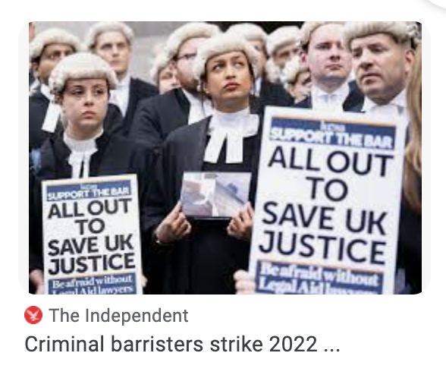
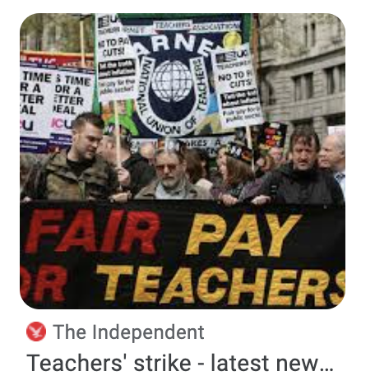
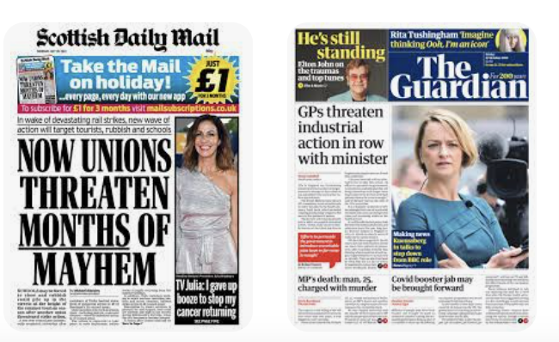
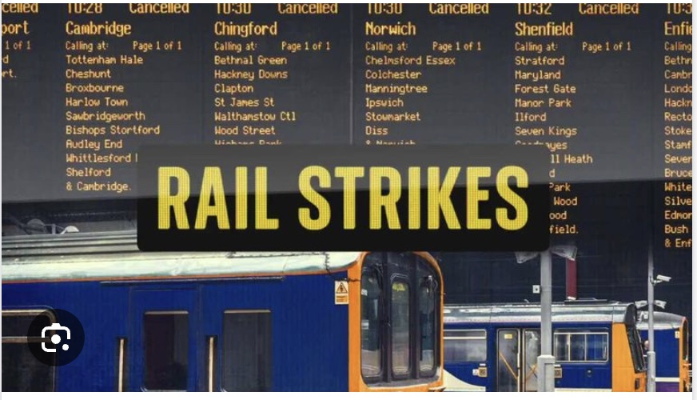

Slide 3
Since May–June 2022, a series of labour strikes and industrial disputes have occurred in various industries of the United Kingdom's economy as workers walked out over pay and conditions.
The strikes took place with rising inflation and demands for pay increases that would keep pace with this inflation.

Slide 4
Proposed Legislation
The Transport Strikes (Minimum Service Levels) Bill (now withdrawn)
The Strikes (Minimum Service Levels) Act 2023
Act came into force on 20 July 2023

Slide 5
Strikes Act 2023
Minimum service for health, fire and rescue, education, transport, nuclear, border security.
Work notices – identify persons required to work during the strike
Reasonable steps – no protection (from tort claims for damages) if union fails to take reasonable steps
Reasonable steps not defined – code of coduct expected
Amends TULRA 1992

Slide 6
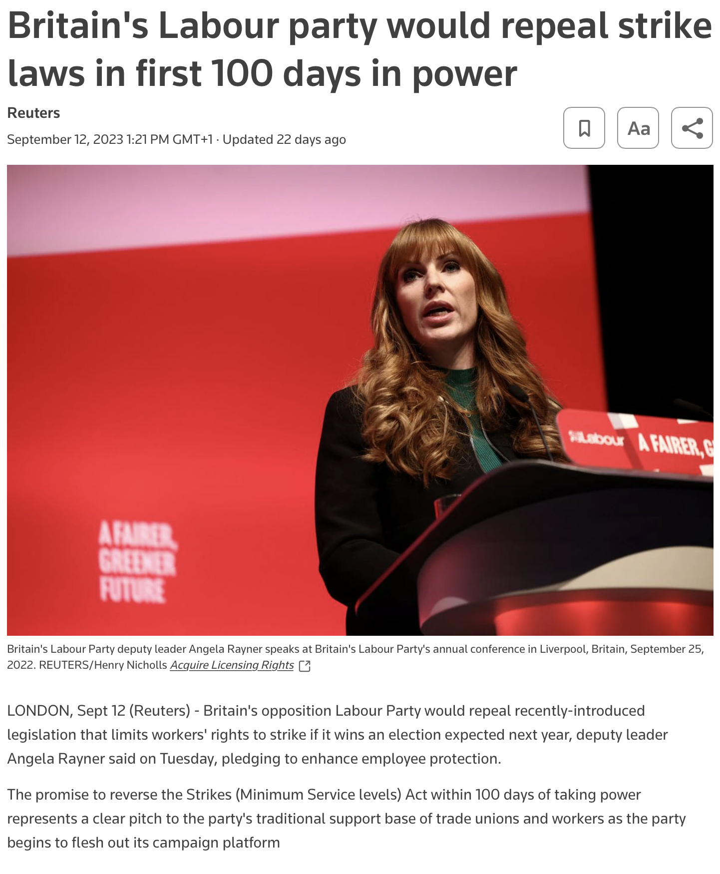
A “spiteful and bitter attack on unions”
"The next Labour Government will ask Parliament to repeal these anti-trade union laws within our first 100 days," she said in a speech at the Trades Union Congress (TUC) annual conference in Liverpool.
She said that Labour would also bring forward an Employment Rights Bill in its first 100 days in office.

Slide 7
Labour policy
Labour will tackle workplace harassment
Labour will require employers to create and maintain workplaces and working conditions free from harassment.
Labour will give those with caring responsibilities greater protections
Labour will strengthen the rights of workers to respond to family emergencies with paid family and carers’ leave, the right to have flexible working.
Labour will act to close gender, ethnicity and disability pay gaps
Labour will enforce the requirement to report and eliminate pay gaps with employers required to devise and implement plans to eradicate these inequalities. The publication of ethnicity pay gaps will be made mandatory for firms with more than 250 staff, to mirror gender pay gap reporting,
Labour will tackle socio-economic discrimination at work
Labour will address socio-economic inequalities in the workplace by enacting the socio-economic duty in the Equality Act 2010. This will require the Government and public sector to deliver better outcomes for lower income people, and to make narrowing and eliminating inequality a priority.

Slide 8
Employee Rights
Pay
Sick pay
Annual leave
Continuous service
Protection from unfair dismissal (but not detriment)
TU activities
Blacklisting

Slide 9
Calculating strike pay
Hartley v King Edward VI College the Supreme Court
It held that a sixth form college should only have deducted 1/365 of salary per day of strike action, as the teachers were engaged on an annual contract and performed work throughout the year. The college’s approach of deducting 1/260 of salary per day (based on a five day working week) was not correct.

Slide 10
Injunctions
To prevent industrial action:
An interim injunction, which is normally sought by the employer shortly after it has presented a claim for damages in tort, restrains a trade union from taking, or continuing, industrial action pending the full trial that will conclusively determine the lawfulness or otherwise of the industrial action (and accordingly, whether or not the union is liable to pay damages in tort).

Slide 11
When is Immunity Lost?
Here is an outline of the circumstances in which the immunity granted by S.219 is lost. This happens where:
a union has taken official industrial action without the support of a secret ballot and/or where a union has not given the employer due notice of industrial action
there is unlawful secondary action
there is unlawful picketing
there is industrial action in support of workers dismissed while taking part in unofficial industrial action
a union has taken industrial action to impose union-only labour conditions or union recognition, or
a union has taken action to impose union membership.

Slide 12
When is industrial action lawful?
three-stage process:
does the action concerned incur common law liability for one of the industrial torts?
does S.219 provide immunity from that liability?
does anything in the TULR(C)A remove the S.219 defence and restore the original common law liability?

Slide 13
What evidence does an employer need to show?
a (non-accidental) breach of the pre-action notice or balloting requirements
an error in the selection of members to ballot or in the balloting process which is on a scale that may affect the result
a breach of a contractual agreement with the employer not to engage in strike action
a failure to include the correct information in a notice to the employer
strike action being taken for the purpose of enforcing union membership, supporting employees dismissed for taking part in unofficial action, or enforcing union recognition
the commission of a tort or torts that fall outside the scope of the statutory immunity
secondary action, or
unlawful picketing.

Slide 14
Notice and balloting
British Airways plc v Unite the Union 2010 IRLR 423, QBD
Mrs Justice Cox granted BA an injunction restraining a 12-day strike by cabin crew due to take place over the Christmas holiday period.

Slide 15
Balloting
Metrobus Ltd v Unite the Union 2010 ICR 173, CA
the Court of Appeal upheld the decision to grant an injunction restraining a strike by bus drivers. Unite had not supplied M Ltd with the correct information in the notice of ballot and notice of industrial action.

Slide 16
Injunctions refused
The courts have declined to grant interim injunctions where they have been satisfied that the breach in question was accidental or trivial.
S.232B, for example, provides that certain ‘small accidental failures’ to comply with the balloting provisions should be disregarded.

Slide 17
Test for injunctive relief
American Cyanamid Co v Ethicon Ltd 1975 AC 396, HL.
  is there a serious issue to be tried?
  would damages be an adequate remedy for the wronged party?
  where does the balance of convenience lie pending trial of the action?
  what are the merits of the case?

Slide 18
Modification for
Industrial Action Disputes
The court’s role at the preliminary hearing is simply to decide whether certain action should be restrained until the matter comes to trial, not to prejudge the substantive issues (which will be determined at the trial).
Exceptions to this general rule, one of the most important being where the interim proceedings would effectively decide the case
This position is given statutory authority by S.221(2) TULR(C)A.

Slide 19
For example…
London Underground Ltd v Associated Society of Locomotive Engineers and Firemen 2012 IRLR 196, QBD
Balfour Beatty Engineering Services Ltd v Unite the Union 2012 ICR 822, QBD

Slide 20
Ex parte
injunction will only be granted until such time as the claimant can give the defendant proper notice of his or her application
labour cases is severely limited. S.221(1) TULR(C)A
the court will need to be satisfied that all reasonable steps have been taken to notify the union and to ensure that it has been accorded an opportunity to be heard on the matter before an interim injunction is granted.

Slide 21
Employee injunctions?
In exceptional circumstances, employees who believe that their wages have been improperly withheld by their employer may be able to obtain a High Court injunction.
Injunctions are occasionally granted as an interim measure to oblige the employer to pay full wages pending the full hearing of a breach of contract claim. There are two types of injunction: mandatory and restraining.

