Slide 1


How to Get the Most out of PRELIMINARY HEARINGS Louisa Simpson
www.pumpcourtchambers.com

Slide 2

Type 1 or Type 2?
ET Rules of Procedure 2013, Rules 53-56
Type 1: the Private PH (case management)
Type 2: the Public PH (substantive preliminary issues)
Be aware of what can & cannot be achieved at either

Slide 3
ET Rules, r. 53(1) – Scope
53. –(1) A preliminary hearing is a hearing at which the Tribunal may do one or more of the following—
(a) conduct a preliminary consideration of the claim with the parties and make a case management order (including an order relating to the conduct of the final hearing);
(b) determine any preliminary issue;
(c) consider whether a claim or response, or any part, should be struck out under rule 37;
(d) make a deposit order under rule 39;
(e) explore the possibility of settlement or alternative dispute resolution (including judicial mediation).

Slide 4
r. 56 – When PHs shall be in public
56. Preliminary hearings shall be conducted in private, except that where the hearing involves a determination under rule 53(1)(b) or (c), any part of the hearing relating to such a determination shall be in public (subject to rules 50 and 94) and the Tribunal may direct that the entirety of the hearing be in public.

Slide 5
“Preliminary issue”
53. –(3) “Preliminary issue” means, as regards any complaint, any substantive issue which may determine liability (for example, an issue as to jurisdiction or as to whether an employee was dismissed).

Slide 6
“Preliminary issue” cont.
Queensgate Investments LLP and others v Millet UKEAT/0256/20:
Q: Does the matter to be dealt with at the PH determine a substantive preliminary issue or application (not for CM).
Apps for interim relief fall within r.53(3), despite not being a final determination of liability [20].
Because they determine underlying (civil) rights and obligations [63], and have permanent consequences.
Mendy v Motorola Solutions UK Ltd [2022] EAT 47:
At private PH for CM, EJ found Cl had brought “no discernible claim of indirect discrimination” – EAT found this was tantamount to a strike out and should have been in public.

Slide 7
rr. 53(2), 54 & 55
53.—(2) There may be more than one preliminary hearing in any case.
54. A preliminary hearing may be directed by the Tribunal on its own initiative at any time or as the result of an application by a party. The Tribunal shall give the parties reasonable notice of the date of the hearing and in the case of a hearing involving any preliminary issues at least 14 days’ notice shall be given an the notice shall specify the preliminary issues that are to be, or may be, decided at the hearing.
55. Preliminary hearings shall be conducted by an Employment Judge alone, except that where notice has been given that any preliminary issues are to be, or may be, decided at the hearing a party may request in writing that the hearing be conducted by a full tribunal in which case an Employment Judge shall decide whether that would be desirable.

Slide 8
The List of Issues
Do them yourself (or get Counsel to), rather than the ET setting them out
Get in there first – before the other side
Attempt to have a LOI agreed (as far as is possible) before the PH
Use the LOI to your advantage – to identify missing info from other side; to set out exactly what is pleaded (& therefore identify any true amendments)
Take care to ensure the LOI accurately reflects your pleadings – Tucker v Partnership in Care Ltd UKEAT/0455/09

Slide 9
The Case Management Agenda
Again – get in there first
And create one joint (if not agreed) CMA for the Tribunal – consider added column for Cl/R
Think about (& have instructions on) in advance:
Correct R identity?
Number of witnesses, timetable & length of hearing
How long it might take to get medical records
FMH in person or remote? Reasonable adjustments required?
Judicial mediation?

Slide 10
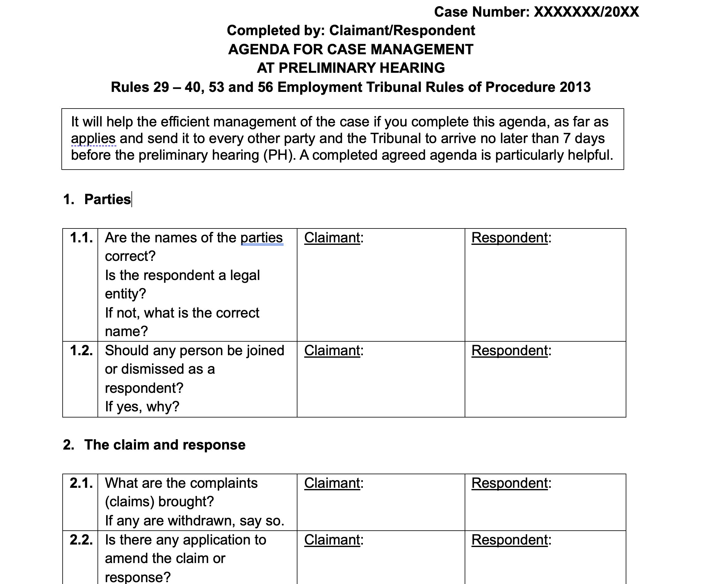

Slide 11
The Bundle
Not strictly necessary – but ET will thank you
Include:
ACAS Cert
Pleadings, incl. any amends
Orders & ET corro
Inter partes corro, only relevant
Joint/agreed CMA & LOI

Slide 12
Instructing Counsel
Have Counsel attending complete CMA & LOI
Ensure Counsel has instructions, in particular, on:
Employment/worker status;
Dates of specific events & employment;
Disability & knowledge;
Any missing/requested info from your side;
Dates to avoid for & relevance of witnesses.

Slide 13
Using a PH (for Case Management) to your advantage
Obtaining missing info
Specific early disclosure
Clarifying claims / apps to amend – r.30
Confirming dates for time limits
EJ indications
Judicial Mediation
OPH required for any purpose?
WhatsApp group with counsel/clients
Be cooperative, appear reasonable

Slide 14
Public Preliminary Hearings
Prepare for oral evidence
Written submissions
Be clear on issues for consideration
Be pro-active and cooperative
Concede where appropriate
Bundles – be proportionate
Be prepared to deal with case management issues at the end

Slide 15
After the PH
Diarise all CMDs
Compare Counsel’s note of dates to the CMO
Write to ET ASAP if any issues with CMO or LOI
Consider settlement discussions

